Slide 1
Computational Thermal Engineering
Diffusion equation and Introduction to C language
DAY 6
Kumaresh Selvakumar

Slide 2
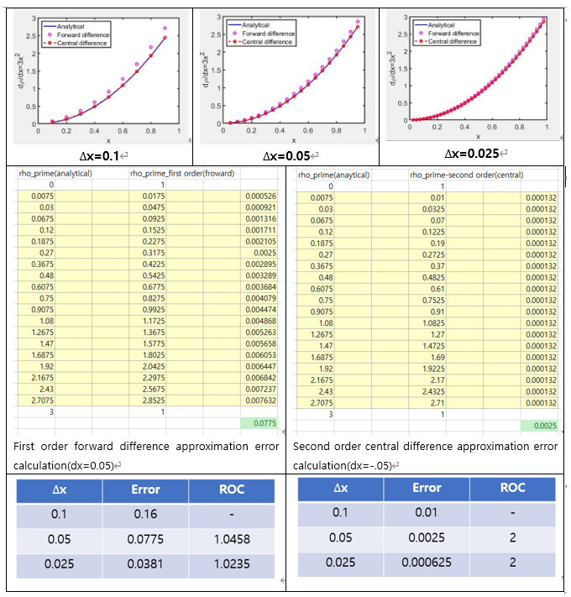
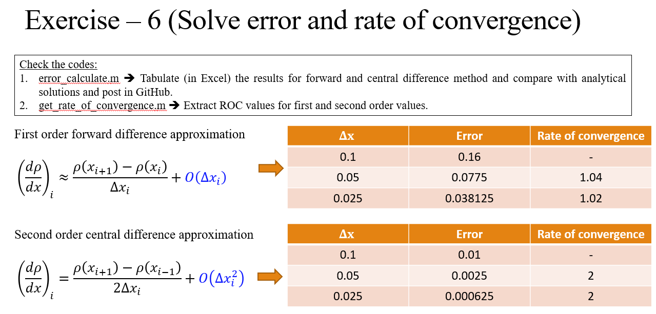
Quick Recap

Slide 3
Contents
Numerical Solution to Diffusion Equation
Exercise – 7 → Diffusion equation
Solve roc (rate of convergence through C++ language)

Slide 4
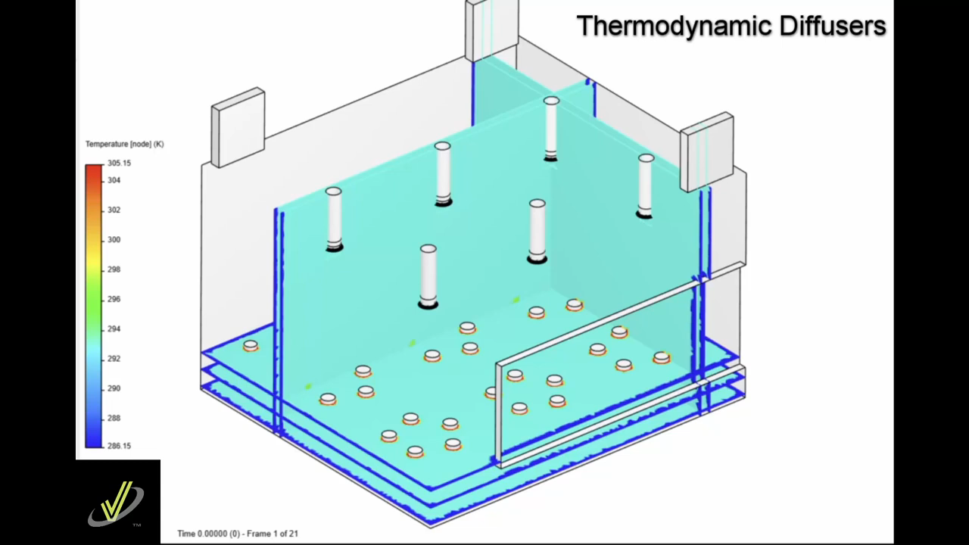
Fick's law describes the movement of particles from a region of high concentration to a region of lower concentration.
Diﬀusion generally represents the transport of a ﬂuid property (momentum) due to ﬂuctuating motions that are not captured by the bulk motion that is represented by the continuum velocity eqn.
Diffusion
Thermodynamic diffusers supply heated air with a downward jet, the difference in air density causes hot air to rise in the first minute after starting the system.
Notes:
https://www.youtube.com/watch?v=Zwa0CA-CyAA
https://www.youtube.com/watch?v=VaZPVV6-VUY

Slide 5

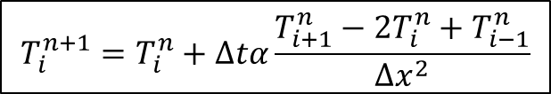
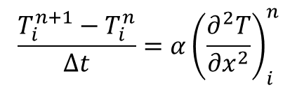
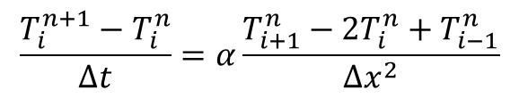
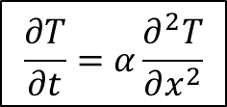

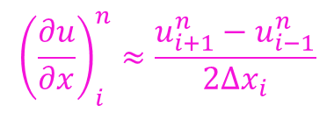
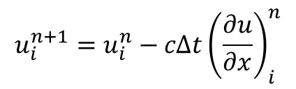
Numerical Solution to Diffusion Equation
$$\frac{∂T}{∂t}=α\frac{∂^{2}T}{∂x^{2}}$$
Time level: $n+1$
$$x_{i−1}$$
$$x_{i}$$
$$x_{i+1}$$
$$x_{i+2}$$
$$\frac{T_{i}^{n+1}−T_{i}^{n}}{Δt}=α{\left(\frac{∂^{2}T}{∂x^{2}}\right)}_{i}^{n}$$
Time level: $n$
$$x_{i+1}$$
$$x_{i+2}$$
$$x_{i−1}$$
$$x_{i}$$
$${\left(\frac{d^{2}T}{dx^{2}}\right)}_{i}=\frac{T\left(x_{i+1}\right)−2T\left(x_{i}\right)+T\left(x_{i−1}\right)}{Δx_{i}^{2}}+O\left(Δx_{i}^{2}\right)$$
Information is from both left and right end
$$\frac{T_{i}^{n+1}−T_{i}^{n}}{Δt}=α\frac{T_{i+1}^{n}−2T_{i}^{n}+T_{i−1}^{n}}{Δx^{2}}$$
$$u_{i}^{n+1}=u_{i}^{n}−cΔt{\left(\frac{∂u}{∂x}\right)}_{i}^{n}$$
$${\left(\frac{∂u}{∂x}\right)}_{i}^{n}≈\frac{u_{i+1}^{n}−u_{i−1}^{n}}{2Δx_{i}}$$
$$T_{i}^{n+1}=T_{i}^{n}+Δtα\frac{T_{i+1}^{n}−2T_{i}^{n}+T_{i−1}^{n}}{Δx^{2}}$$
Central difference

Slide 6
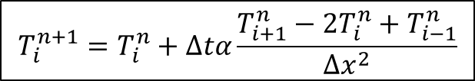
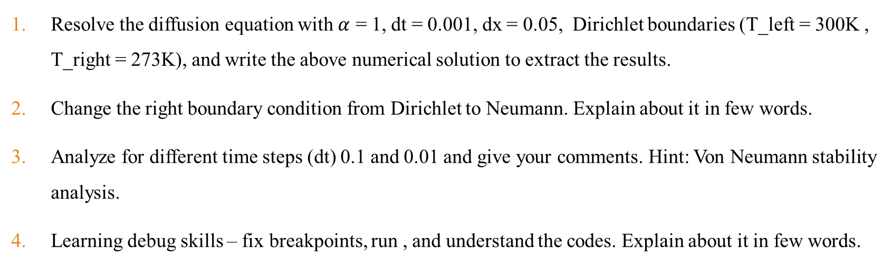
Exercise – 7 (Let’s solve the Diffusion Equation)
$$T_{i}^{n+1}=T_{i}^{n}+Δtα\frac{T_{i+1}^{n}−2T_{i}^{n}+T_{i−1}^{n}}{Δx^{2}}$$
a7_solve_diffusion_sample.m
Resolve the diffusion equation with $α$ = 1, dt = 0.001, dx = 0.05, Dirichlet boundaries (T_left = 300K , T_right = 273K), and write the above numerical solution to extract the results.
Change the right boundary condition from Dirichlet to Neumann. Explain about it in few words.
Analyze for different time steps (dt) 0.1 and 0.01 and give your comments. Hint: Von Neumann stability analysis.
Learning debug skills – fix breakpoints, run , and understand the codes. Explain about it in few words.
Notes:
https://ezgif.com/maker
Dirichlet boundary conditions assume the solution to the variable.
In Neumann boundary conditions, a solution is assumed for the derivative of the variable.
https://en.wikipedia.org/wiki/Von_Neumann_stability_analysis

Slide 7
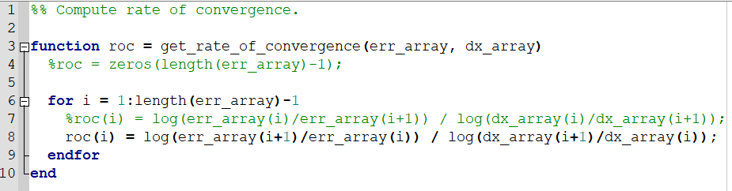
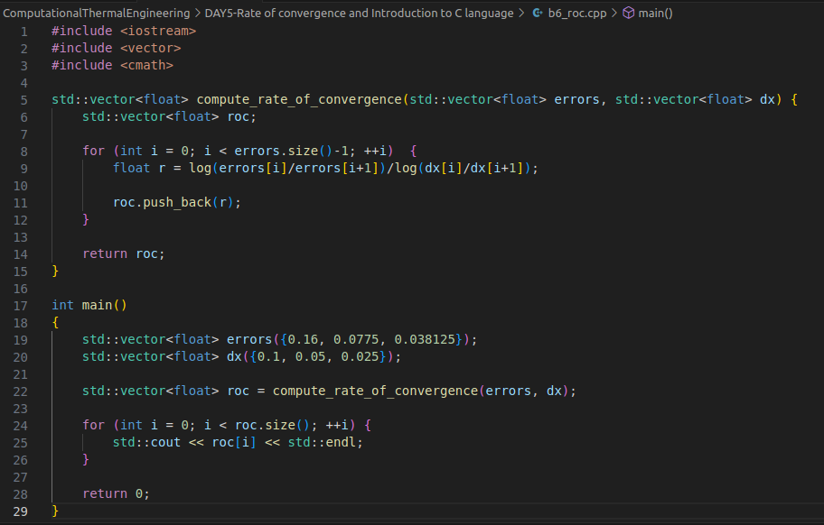
Solve roc (rate of convergence) by C++ language
Check the code: get_rate_of_convergence.m
Check the code: b6_roc.cpp

Slide 8
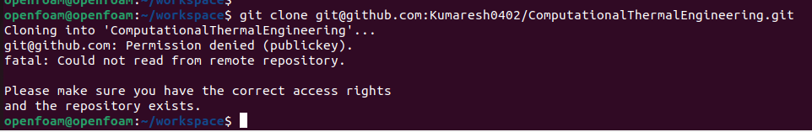
Solve roc by C++ language (Upload the data and results in Exercise-6)
Clone the data from GitHub
Open and download files from Day 6 directory and check, run b6_roc.cpp.
Compile and understand the code.

Slide 9
Next session
(24th October, 2023)
Introduction to OpenFOAM.
Finite volume method to solve diffusion equation in OpenFOAM.
Project 1 - This work will be scrutinized critically.

Slide 10
Research Project Presentation
(31st October, 2023)
- Every individual should take a presentation for 15 minutes. This topic carries high marks. Please prepare and present it carefully.
- Query session: 5 minutes.
- Every individual should ask a single question during the presentation.

